Slide 1
Using a Grid Enabled, Virtual Screening Platform to Discover Unique Inhibitors for SSH-2
Phillip Pham
University of California, San Diego
Notes:
Change the front slide,
Truncate the ssh2 protein description to 1 slide **
Add methods section including Pragma
Include complications slides

Slide 2
Project overview
The objective of this study is to determine a unique inhibitor for the protein SSH-2 via virtual screening experiments performed on the grid.
Utilized the molecular simulation software DOCK 6.
  Determines affinity levels among a vast array of inhibitors.
  Screened against the drug-like subset of the ZINC 7 database.
  Grid computing greatly improves the speed of screening experiments of this magnitude.
DOCK 6 was a preferable platform to executing the screen as opposed to other programs.
ZINC03869281 (2-amino-3-phosphonooxy-propanoic acid).
Notes:
B2: to perform the virtual screening experiments
B3: Highly customizable
B4:From this study, the most promising inhibitor for specificity was determined to be
Previously established method proven to be successful by Levesque et al. (2008)

Slide 3
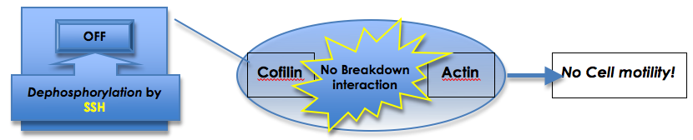
The SSH-2 Protein
Cells maintain their shape through a network of protein structures called the cytoskeleton.
Disassembly and reassembly of cytoskeletal filament proteins promote cell motility.
  The main protein in cytoskeletal filaments is actin.
The deconstruction of actin is regulated by a protein called cofilin.
In order to deactivate cofilin, it is dephosphorylated by SSH-2.
SSH-2 is a protein that belongs to a specific subclass of proteins called dual specificity phosphatases (DSP).
Discovering a specific inhibitor would provide insight into the regulation of cell growth as well as the progression of cancer and Alzheimer’s disease.

Slide 4
Procedural Overview: Assembling Screening Platform
Installation and configuration of the appropriate programs on each cluster of interest.
  Opal OP
  DOCK 6
  Jakarta Tomcat Container
Chimera was used for molecular visualization.
Initiated several successful test runs.
Initiated a general screening experiment using computationally non-intensive parameters.
Notes:
B4: to ensure that the current installations on the five valid clusters were indeed functional
## computationally nonintensive parameters… be prepared to answer this
Truncated:It was a common issue that certain clusters produced differing energy scores during test screens.
Determined which clusters were reliable and conducive to the acquisition of precise results.

Slide 5
Procedural Overview: 2nd Phase SSH-2 Screening
Generated appropriate input files for the 2nd phase docking.
Performed a 3-Angstrom screen and AMBER screen on SSH-2.
After further test runs estimated that the completion of the 3-A would take 4 days and the AMBER screen would take 5 days.
Completed SSH-2 AMBER DOCK screen against the database previously built from the 1st phase SSH-2 DOCK screening results.
A consensus ranking list, relating the ranking of 3-Angstrom DOCK screening and AMBER DOCK screening was obtained.
Notes:
A test file, containing varied types of ligands, was used for testing. It contained a small pool of molecules relative to the amount in the drug-like subset.
.bmp grid file determines how deep of a penetration is permissible when a ligand is bonding to a receptor.
.nrg grid file takes into account molecular forces.

Slide 6
Screening VH1 for determining specificity
VH1 is a DSP which contains structural and chemical properties similar to that of SSH-2.
The reranked, rebuilt database of molecules obtained from the SSH-2 screenings were screened against the VH1 crystal structure.
      3A and AMBER screenings
The DOCK input parameters were conserved when initiating the VH1 screenings.
Upon completion a consensus list was built, and the rankings between VH1 and SSH-2 were then compared to determine possible specific inhibitors.
Notes:
VH1 was expressed as one of the key DSP’s compared to SSH-2 in the SSH-2 crystal structure paper.

Slide 7
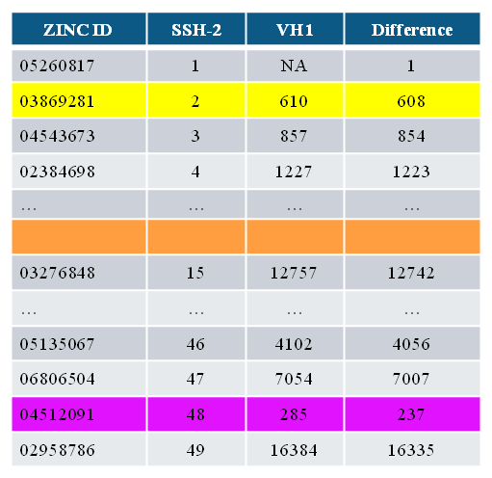
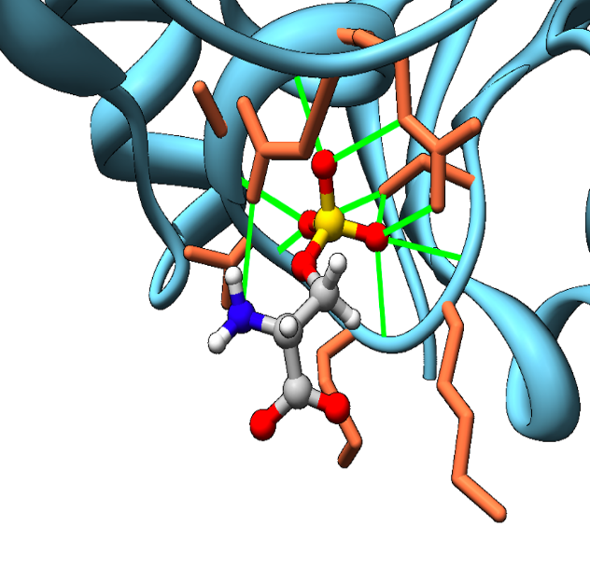

Results: Specificity Based on Rank
The disparity of consensus rankings between the VH1 and SSH-2 of the top-ranked molecule in the SSH-2 consensus screening (ZINC03869281) had a respectable turnout of 608 ranks.
The smallest disparity: 237 ranks
The largest disparity: 19939 ranks
Further visualization of ZINC03869281 through Chimera shows strong H-bond interaction between the phosphate end of the molecule and the catalytic site of SSH-2.
Notes:
~This is after the 0.3 angstrom and AMBER screenings of both SSH-2 and VH1.
~ Disparity rankings out of the top 50 molecules
B4: as expected form DSP’s. Will explain through presentation THE REASON.

Slide 8
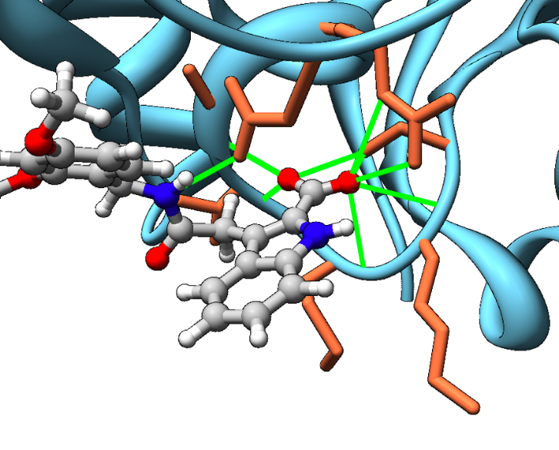
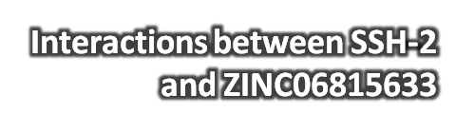
Results: Patterns of Interest
Among the top 50 ranked molecules for SSH-2, ZINC06815633 had the greatest disparity in rank among the consensus lists: 19939 ranks
Reveals a potential inhibitor compound, specific to SSH-2 over VH1, and possibly all other DSPs.
Notes:
Could be another potential inhibitor specific to only SSH-2!
Other ways to characterize specificity.
STRESS2nd bullet
~~ add the

Slide 9
Issues: Java Related Errors
During the AMBER dock screen, “java <defunct>” processes gradually increased on the rocks-52 cluster.
  There was an accumulation of “zombie processes” that triggered a “fork-failed”. In the case of the dock screen, the zombie process was the aforementioned “java <defunct>” process.
The source of this error was determined to be an older version of java (jdk1.5.0_05).
A workaround by assigning the rocks-153 cluster as the main cluster solved the problem, since it had an updated java version (jdk1.5.0_07) already installed.
Notes:
Rocks-52 was the “master cluster” for sending and receiving job data from the other “slave clusters”. [bullet 1]
error, preventing the user from accessing the cluster of interest until the cluster administrator manually kills each of the processes (bullet 2)
“Zombie processes” are processes that could not be killed directly via “top” or “kill -9” functions within the command line. They are child processes which are tied directly to the parent process. It is obvious that this error is an inconvenience to both the grid user and the administrator.
Ultimately, collecting results in a timely fashion was deemed to be more important.

Slide 10
Issues: AMBER prep
During the AMBER screening, 17 molecules in select slices were incompatible with the amber_prep.pl script.
Much time and resources was wasted from rescreening the slices containing these molecules.
It was deemed necessary to delete these molecules from the slices but would have minimal impact on our screens.
The database with deleted molecules was used in the VH1 screening to prevent future complications with amber_prep.pl.
Notes:
B3: the error is insignificant in the grand scheme of finding an inhibitor
Stress Bullet 3.

Slide 11
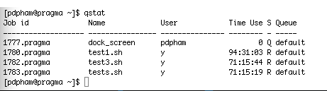
Issues: Grid Usage
Jobs submitted by other users on the grid often times interfered with the efficiency expected in a particular DOCK screen.
Other users using different submission schemes, such as repeated submissions of jobs using only one processor, would limit grid usage for users who submit a single batch job utilizing multiple processors at a time.
Schedulers at times favor certain users, leaving DOCK screen jobs in queue status for more than six days.

Slide 12
Conclusion
This study was an overall success.
  2 DSP’s were virtually screened against the drug-like subset.
  Familiarization with virtual screening procedures across the grid.
  Possible inhibitors were determined.
The future direction:
  Extensive comparison between SSH-2 and VH1 results.
  Virtual screening of other DSP’s for further specificity confirmation.
  Wet bench lab testing of these possible specific inhibitors.

Slide 13






Acknowledgements
University of California, San Diego / PRIME
  Dr. Jason Haga
  Marshall Levesque
  Dr. Peter Arzberger
  Dr. Gabriele Wienhausen
  Teri Simas
Osaka University
  Dr. Susumu Date
  Seiki Kuwabara
  Kohei Ichikawa
  Yasuyuki Kusumoto
  Dr. Shinji Shimojo
The National Science Foundation

